Slide 1
ASSESSING THE EFFECT OF FLOODING ALONG THE RIVERINE COMMUNITIES IN NUMAN, ADAMAWA STATE, NIGERIA
Qudus Taiwo
National Centre for Remote Sensing Nigeria

Slide 2
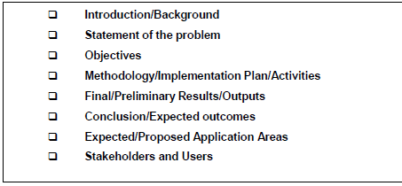

Slide 3
Flooding is caused by several factors and is invariably preceded by heavy rainfall.
Most parts of the central states of Nigeria and other adjoining states along the rivers Niger and Benue are often inundated and devastated by these flooding events.
This causes huge destruction to the rural and urban infrastructure (farmlands/crops, roads, buildings, drainages, bridges, power lines, etc) and socio- economic lives of the areas.
Numan local government, which is the research area, experience yearly discharge of water from Lagdo dam from Cameroon
The discharge have continuously endangered the lives and property of the populace due to flood occurrence
Though the state had also faced severe flood disasters in 2000 and 2007
However, the last few years (2012 - 2022) has proved to be one of the worst period both in magnitude and frequency National Emergency Management Agency (2022).

Slide 4
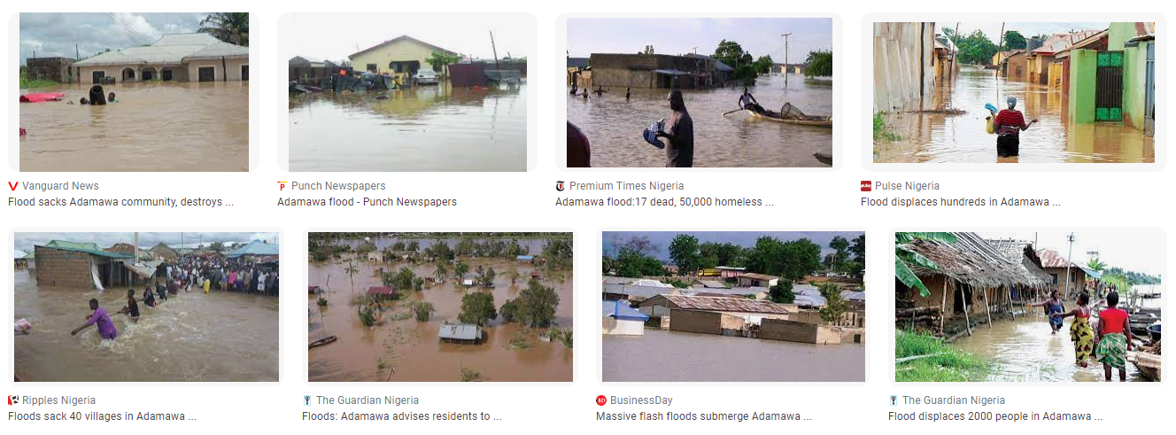
IMAGES OF ANNUAL OCCURRENCES OF FLOODING IN NUMAN NIGERIA

Slide 5
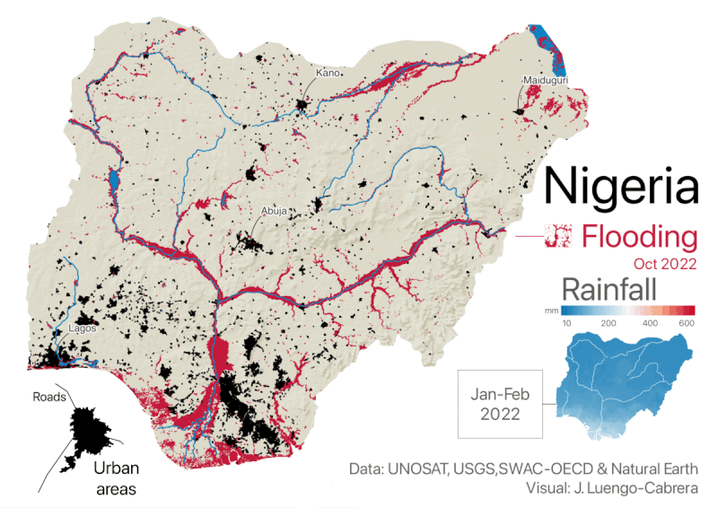
Occurrence of flood in Nigeria is astronomical
Almost all states of Nigeria are affected
The Federal Government NEMA is overwhelmed
Resettlement of the affected communities to
safer places are daunting
The affected communities are filled with anxiety
Selective disbursements of funds to the flood
victims
Traditional attachment to ancestral homes
NIMET early warnings on likely increase in rainfall
November was not heeded.
The Objectives are to use NigeriaSat2 image to identify areas that are prone to flooding and affected by flooding

Slide 6
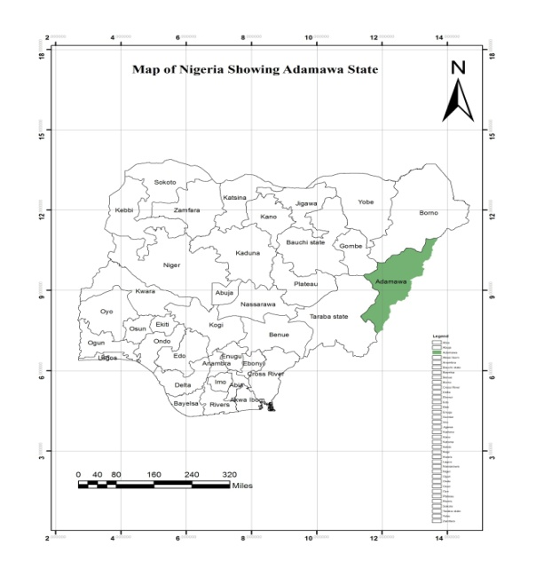
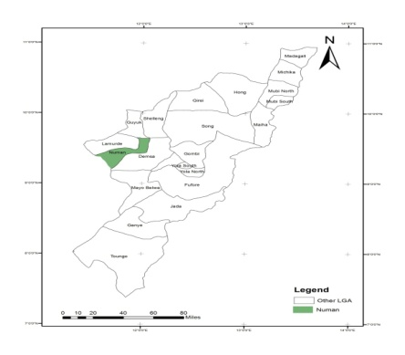
Numan is located within 9°28′N and 12°2′E
It is bordered by Guyuk town to the North, Shelleng to the Northeast, Lamurde to west, Yola south to the south
Numan occupies about 746.38 square kilometers.
Has a total population of about 91,549 people
The mean annual rainfall in this area is 140-160cm annually.
The average annual Temperature is 23°C
The vegetation is guinea savanna
Topographically, these areas are mountainous land

Slide 7
Primary Data | Source | Format | Resolution | Purpose.
G.P.S | N.C.R.S | Garmin GPS |  | Points Location
Pictures |  | Digital |  | Observation
Secondary Data | Source | Format | Resolution | Purpose.
NigeriaSat2 | NASRDA | Raster | 30m | Land use and Land cover
Topographic map | OSGOF | Vector | 1:50,000 | Digitized for DEM
SRTM | NASRDA | Raster | 30m | Creating DEM
Settlement Map | NASRDA | Vector | 1:50,000 | Location of Settlements
Meteorological data and drainage maps | Upper Benue Authority, Yola | Chart and Map | 1:50,000 | For rainfall and drainage pattern

Slide 8
A Hp Scanner
A Hp Laptop
Hp Desk Jet color Printer
Garmin hand held GPS
Digital camera
ArcGIS 10.1
ERDAS Imagine 9.2

Slide 9
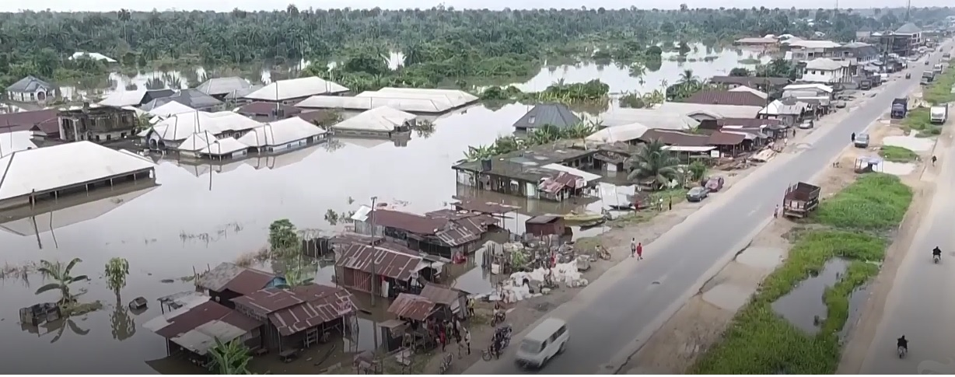

Slide 10
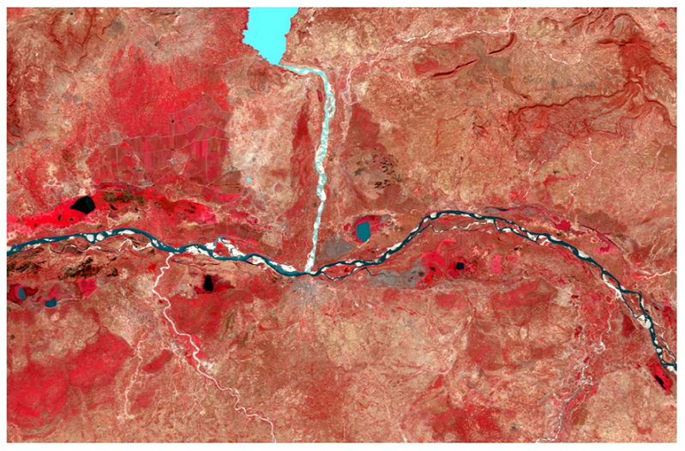
RECENT NIGERIASAT-2 SATELLITE IMAGE OF THE STUDY AREA

Slide 11
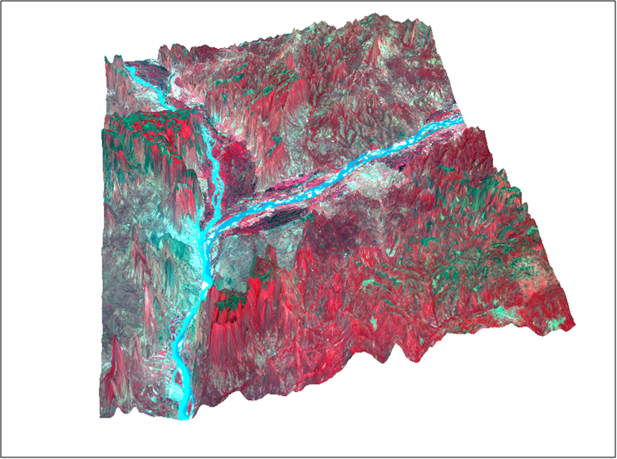
NIGERIASAT-2 IMAGE IN 3D BEFORE THE FLOOD

Slide 12
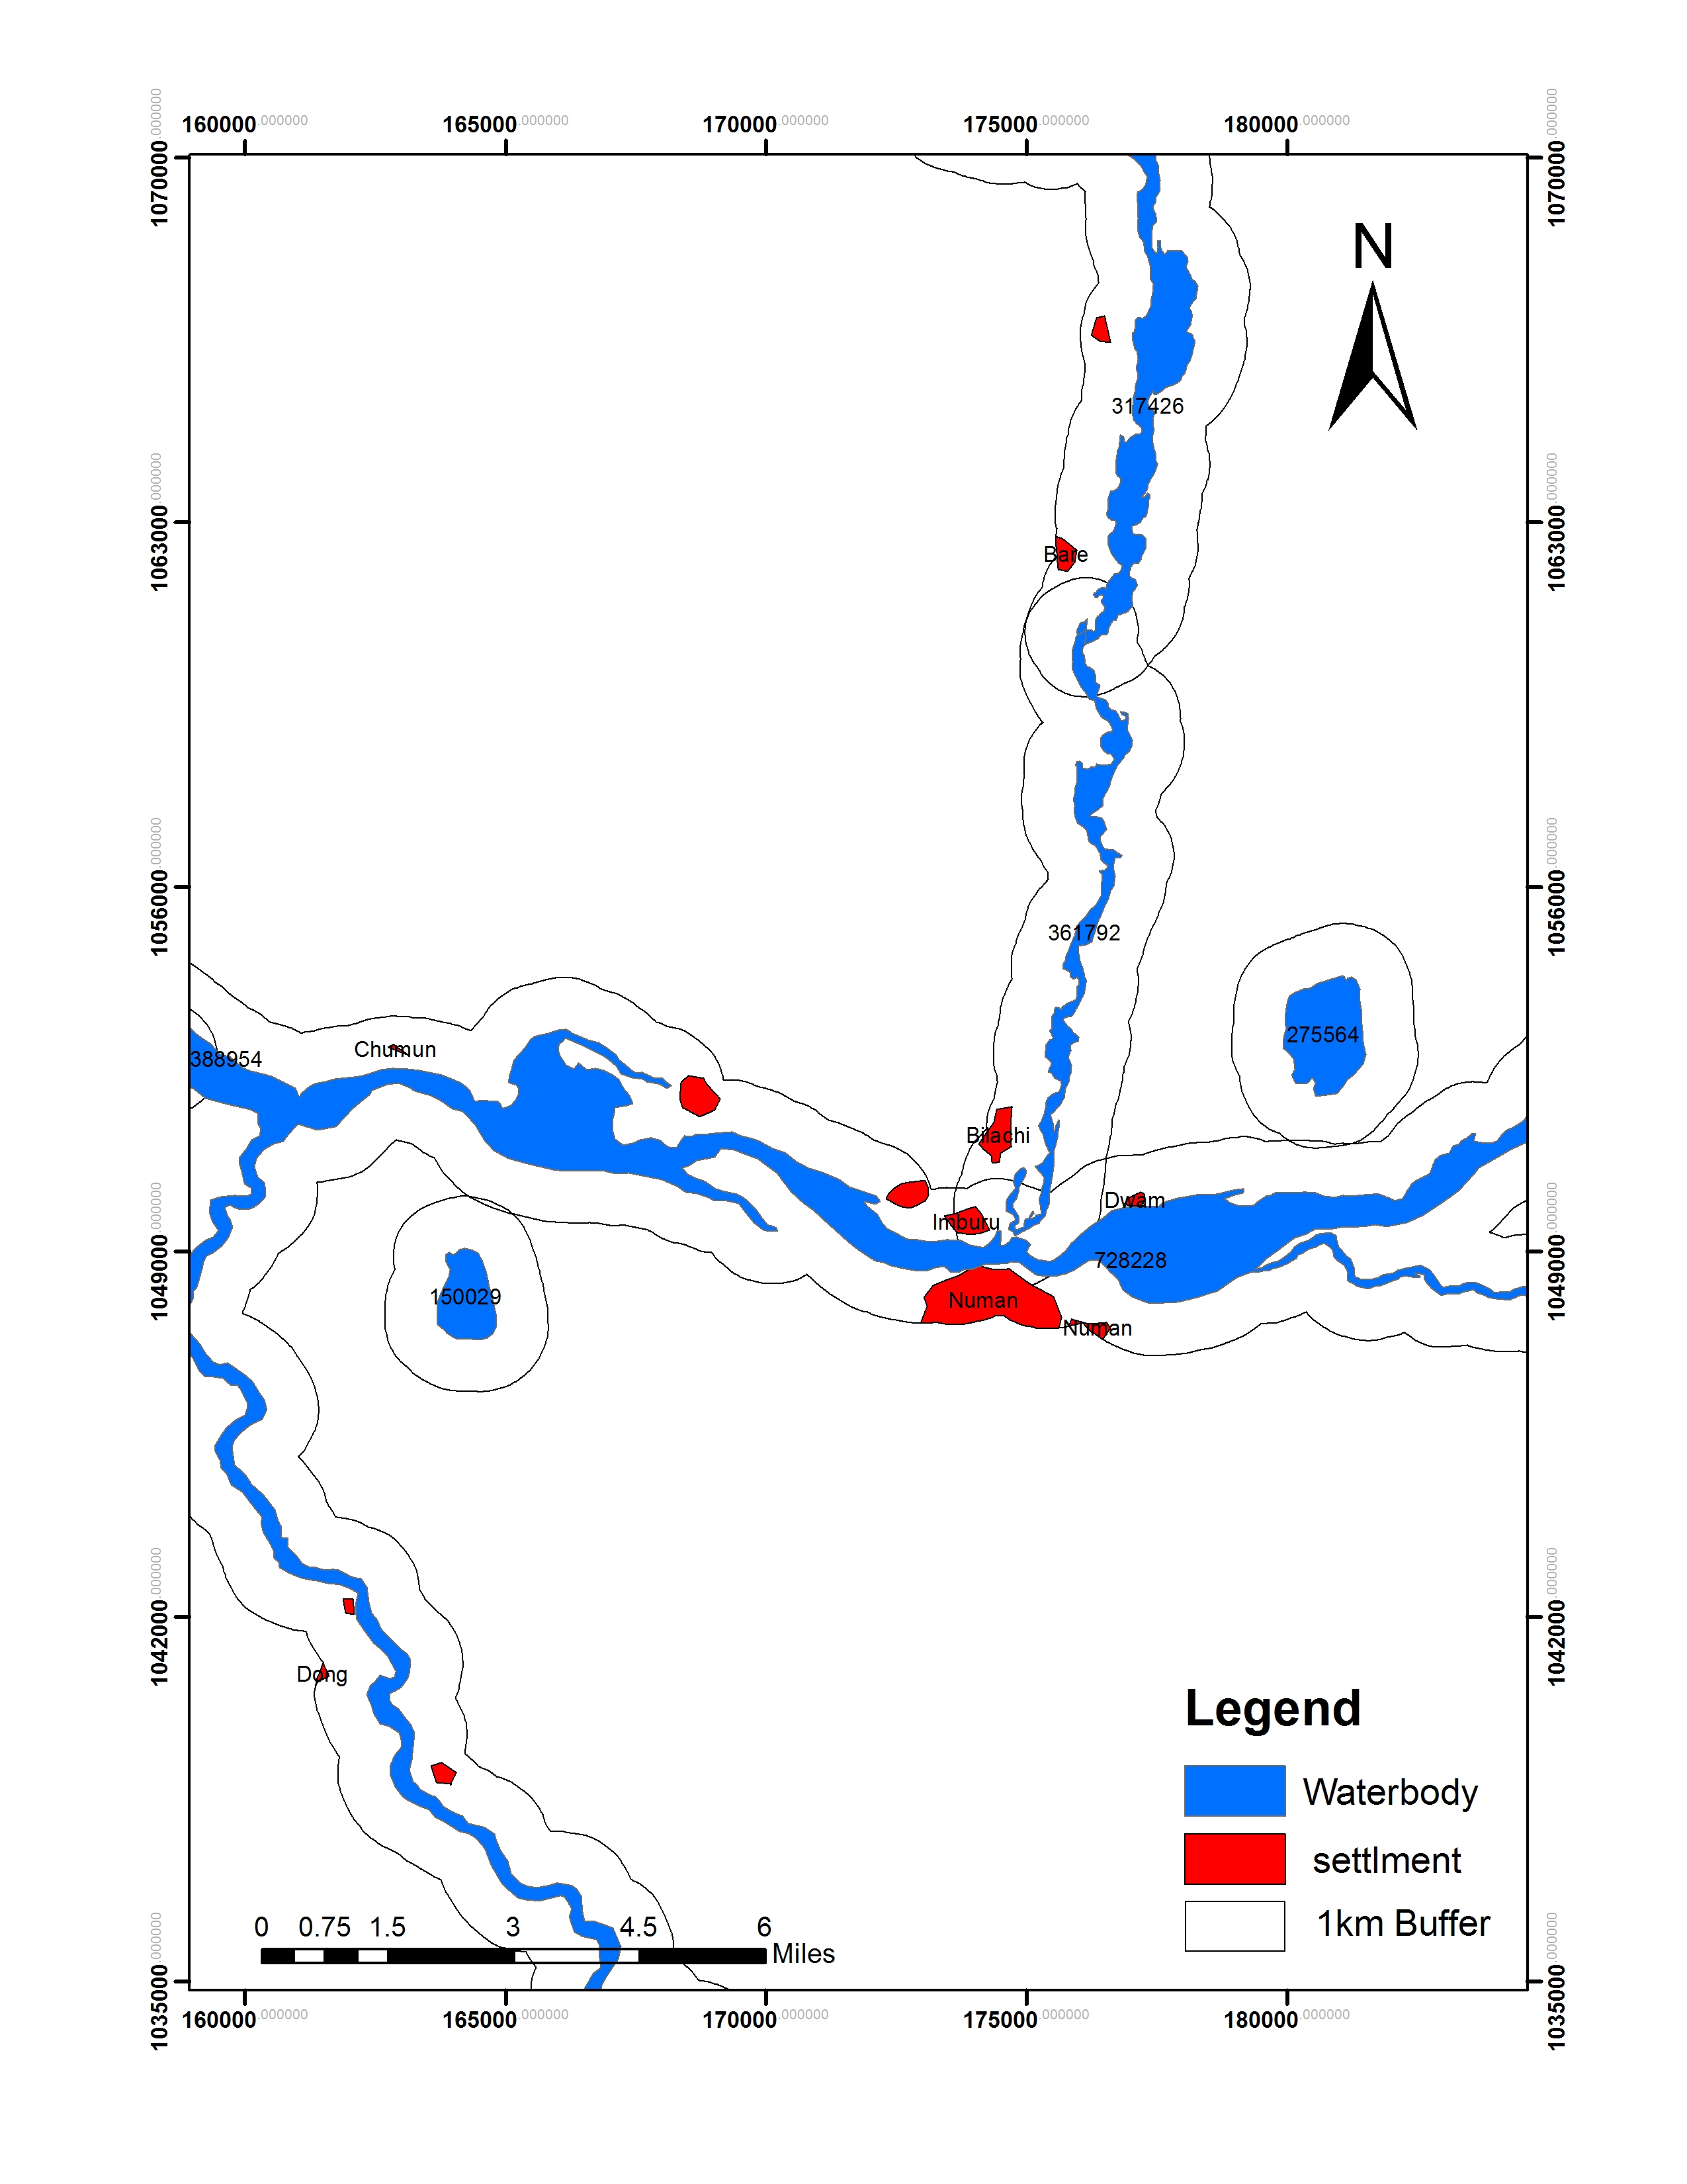
MAP SHOWING 1.1KM BUFFER DISTANCE WITHIN STUDY AREA

Slide 13
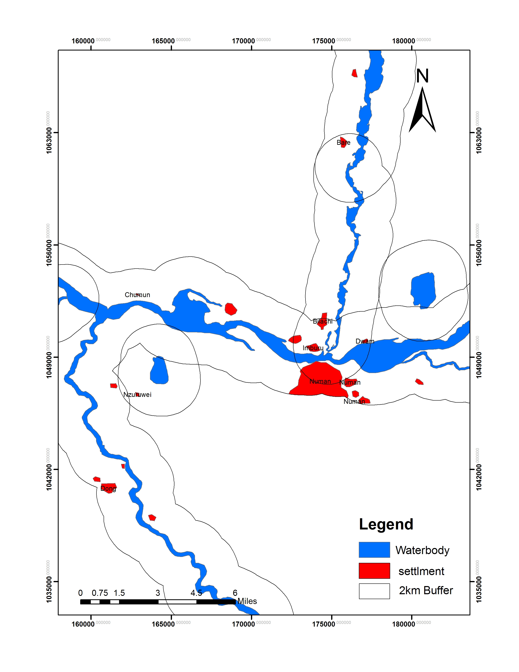
MAP SHOWING 2.2KM BUFFER DISTANCE WITHIN STUDY AREA

Slide 14
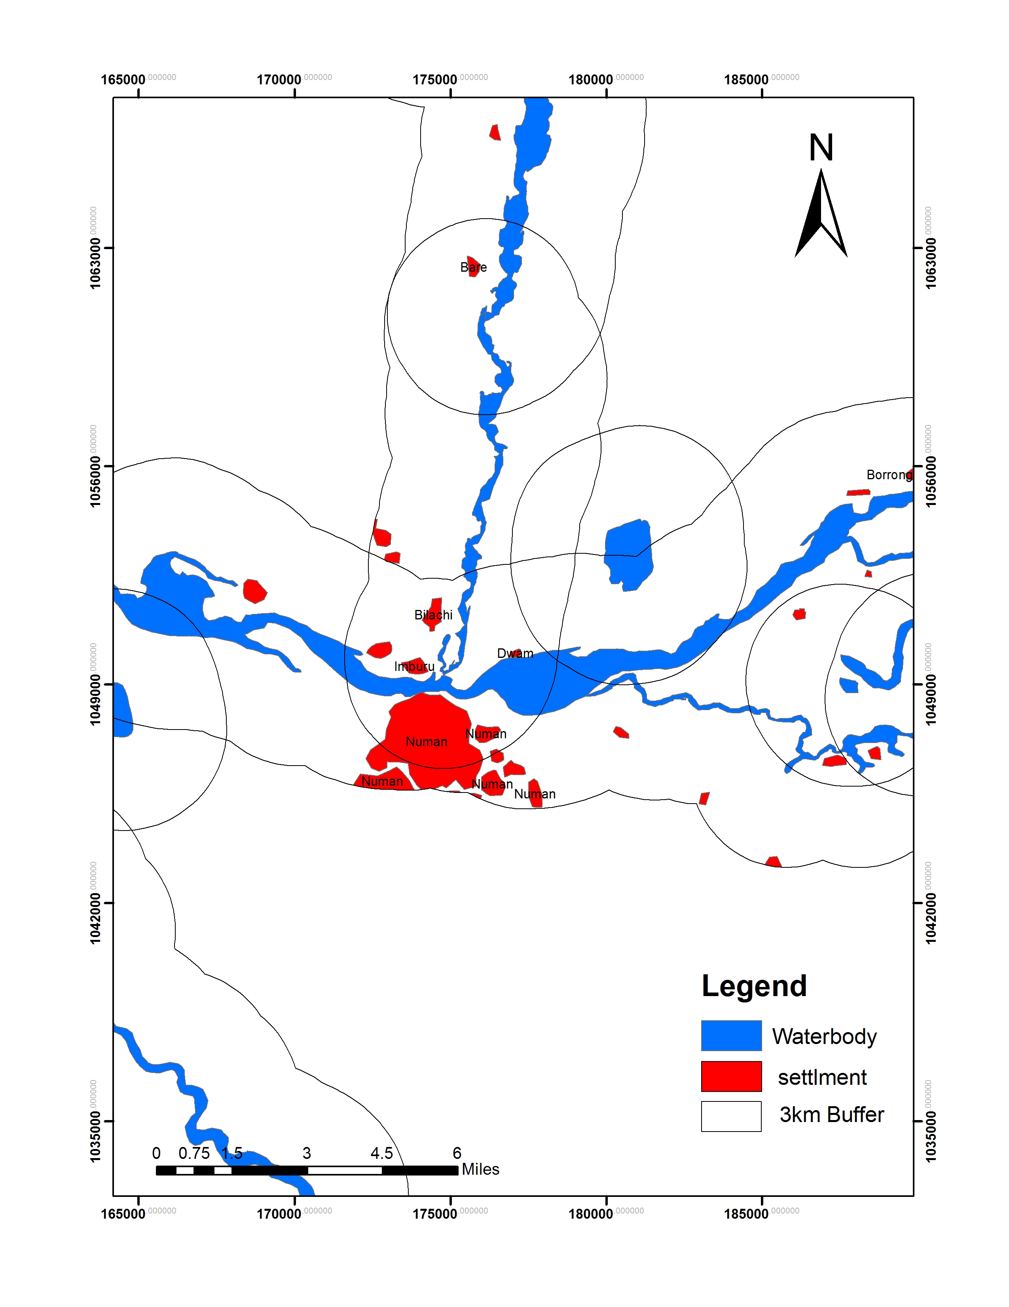
MAP SHOWING 3.3KM BUFFER DISTANCE WITHIN STUDY AREA

Slide 15
NIGERIASAT2 IMAGE SHOWING AREAS COVERED AFTER THE FLOOD 2022

Slide 16
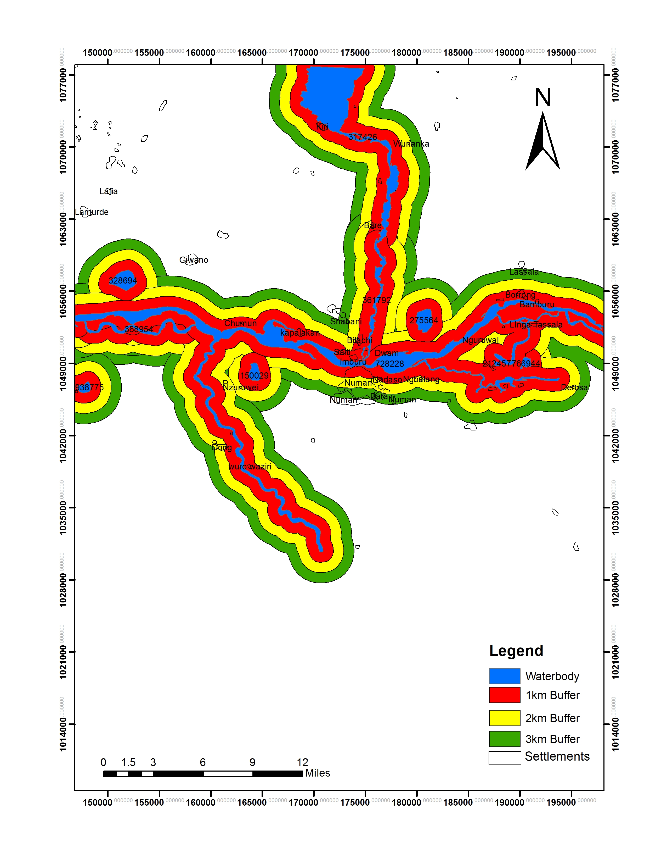
MAP SHOWING COMPOSITE BUFFER DISTANCE WITHIN STUDY AREA

Slide 17
Buffer Distance | Number of Submerged Households | % of the Total
1km | 27 | 29.4
2km | 29 | 31.5
3km | 36 | 39.1
Total | 92 | 100
TABLE SHOWING BUFFER DISTANCE AND VUNERABLE HOUSEHOLDS

Slide 18
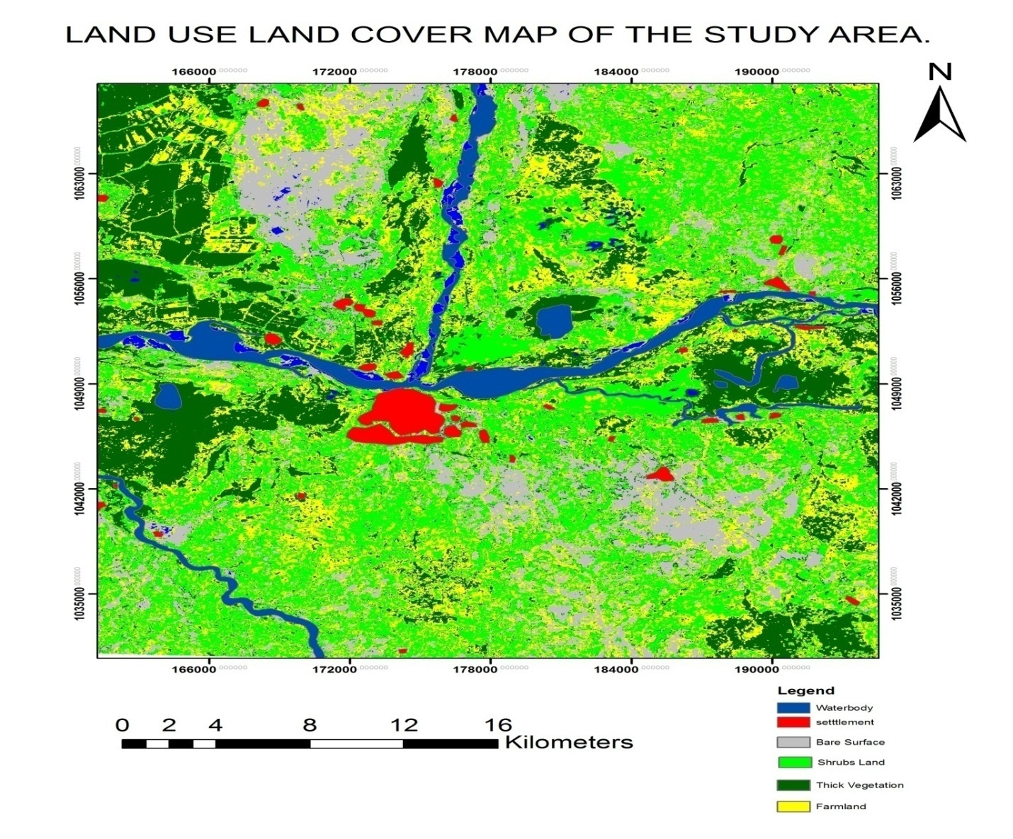

Slide 19
Land cover | Area(sqm) |  | Percentage % | Area(Hc)
Water body | 233706.00000 |  | 3.235341593 | 323.5341593
Farmlands | 2021952.00000 |  | 27.9911744 | 2799.11744
Thick vegetations | 1446991.00000 |  | 20.03162164 | 2003.162164
Shrub Land | 2511884.00000 |  | 34.77361635 | 3477.361635
Bare surface | 989951.00000 |  | 13.70452468 | 1370.452468
Settlements | 19050.00000 |  | 0.263721331 | 26.37213309
Total |  | 7223534.00000 | 100 | 10,000.
TABLE DERIVED FROM LAND USE/LAND COVER OF THE AREA

Slide 20
The result shows areas such as Numan town, Dwam, Imburu, Bilachi, Nglang are highly vulnerable
Elevation of these communities is less than 250m above sea level
Their proximity to the river is high risk.
Also areas ranging between 150.00m to 200.00m above sea level are less vulnerable to flood hazard.
Most of these places have not been authorized.
Some settlements are located on waterways.
The main danger is the opening of Lagdo dam at certain periods of the year after heavy rainfall
While areas that fall on elevation ranging from 350.00m to 800.00m above sea level are less vulnerable to flood d

Slide 21
SUBMERGED HOUSES IN NUMAN AFTER THE FLOOD

Slide 22
FLOOD ON GOMBE – YOLA ROAD AFTER THE FLOOD

Slide 23
This study was initiated with the central aim of making the use of RS and GIS techniques to map out areas that are affected by flooding within Numan area.
This was achieved by generating maps assessing areas affected by flood as well as areas vulnerable to flood within the LGA
The result is expected to assist decision makers especially those in charge funds distribution to affected communities

Slide 24
The following can be recommended for a flood free town:
1. Increase public awareness by Nigeria Meteorological Agency, National Orientation Agency and the National Emergency Management Agency to discourage people from settling along flood prone areas
2. There is an urgent need to revisit the construction of a receptive dam at the upstream Lagdo Dam by Ministry of Water Resources and the National Hydrological Agency.
3. Remote Sensing Data from National Space Research and Development Agency (NASRDA) for flood disaster related researches should be utilised
4 There should be strong synergy amongst all relevant agencies especially those with research data
5. Afforestation program by Ministry of Environment and North East Zone Arid Project(NEZAP) in the country should also be intensified

Slide 25
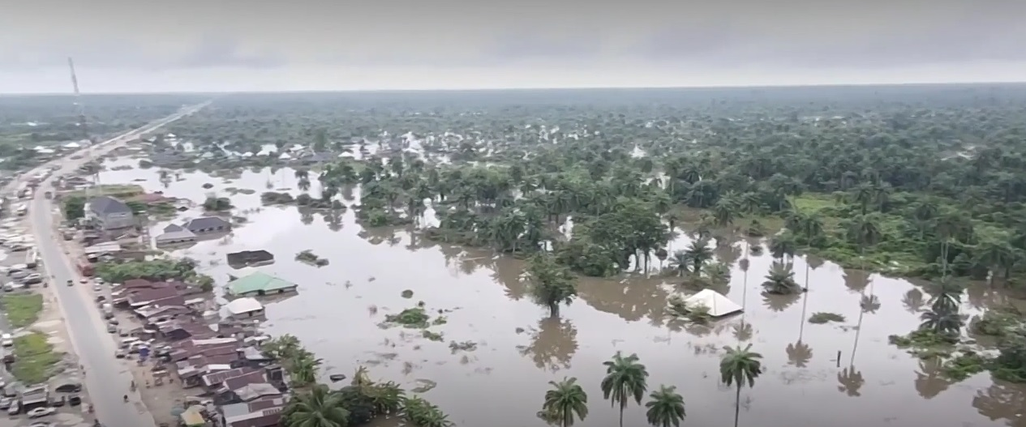
Thank you for Listening

